Slide 1
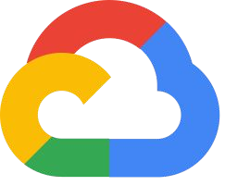
GCP For DevOps
:- By Pulkit Dhingra

Slide 2
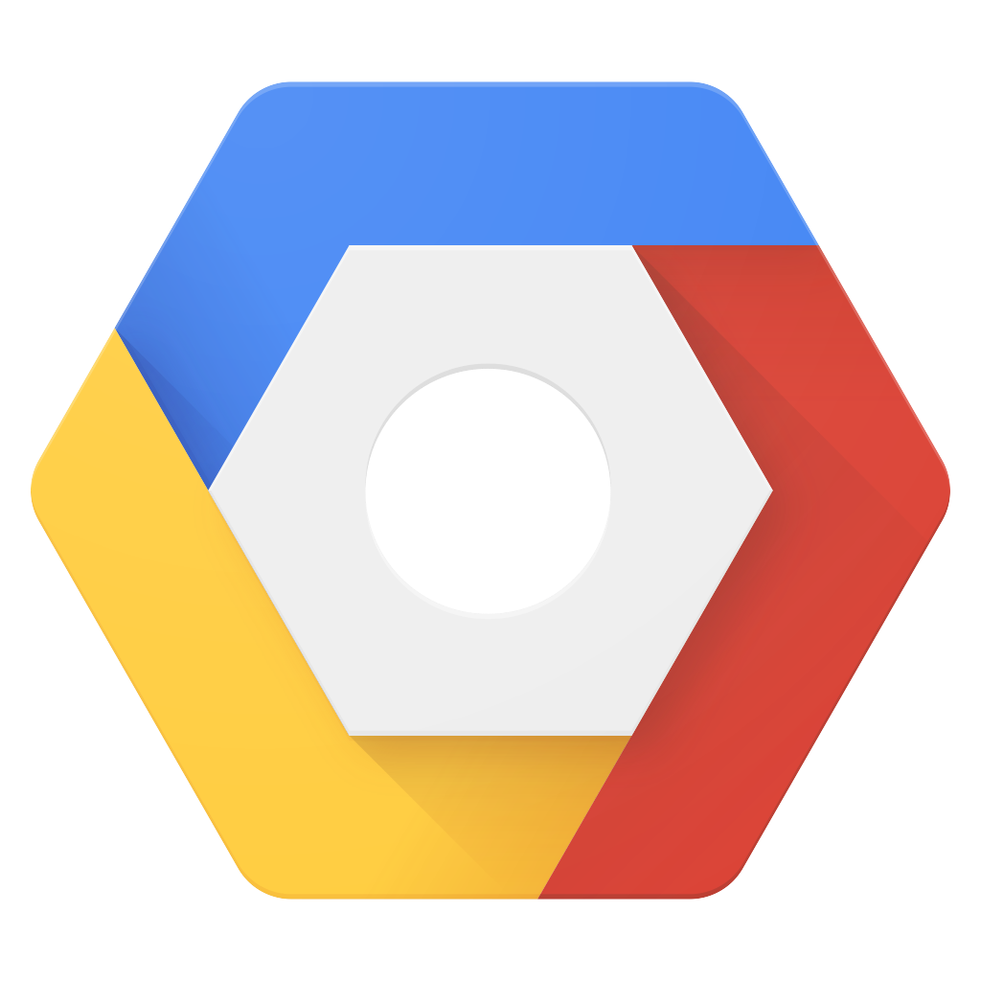
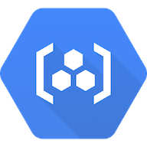

AGENDA
CI/CD
DEMO
Continuous Integration
And
Continuous Deployment
with Google Cloud Platform
Overview to the
Google Cloud
DevOps tools GCP

Slide 3
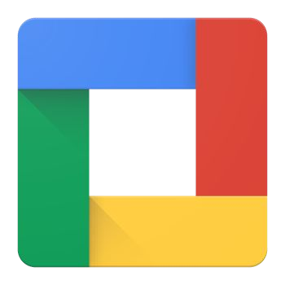
Google Cloud Platform

Slide 4




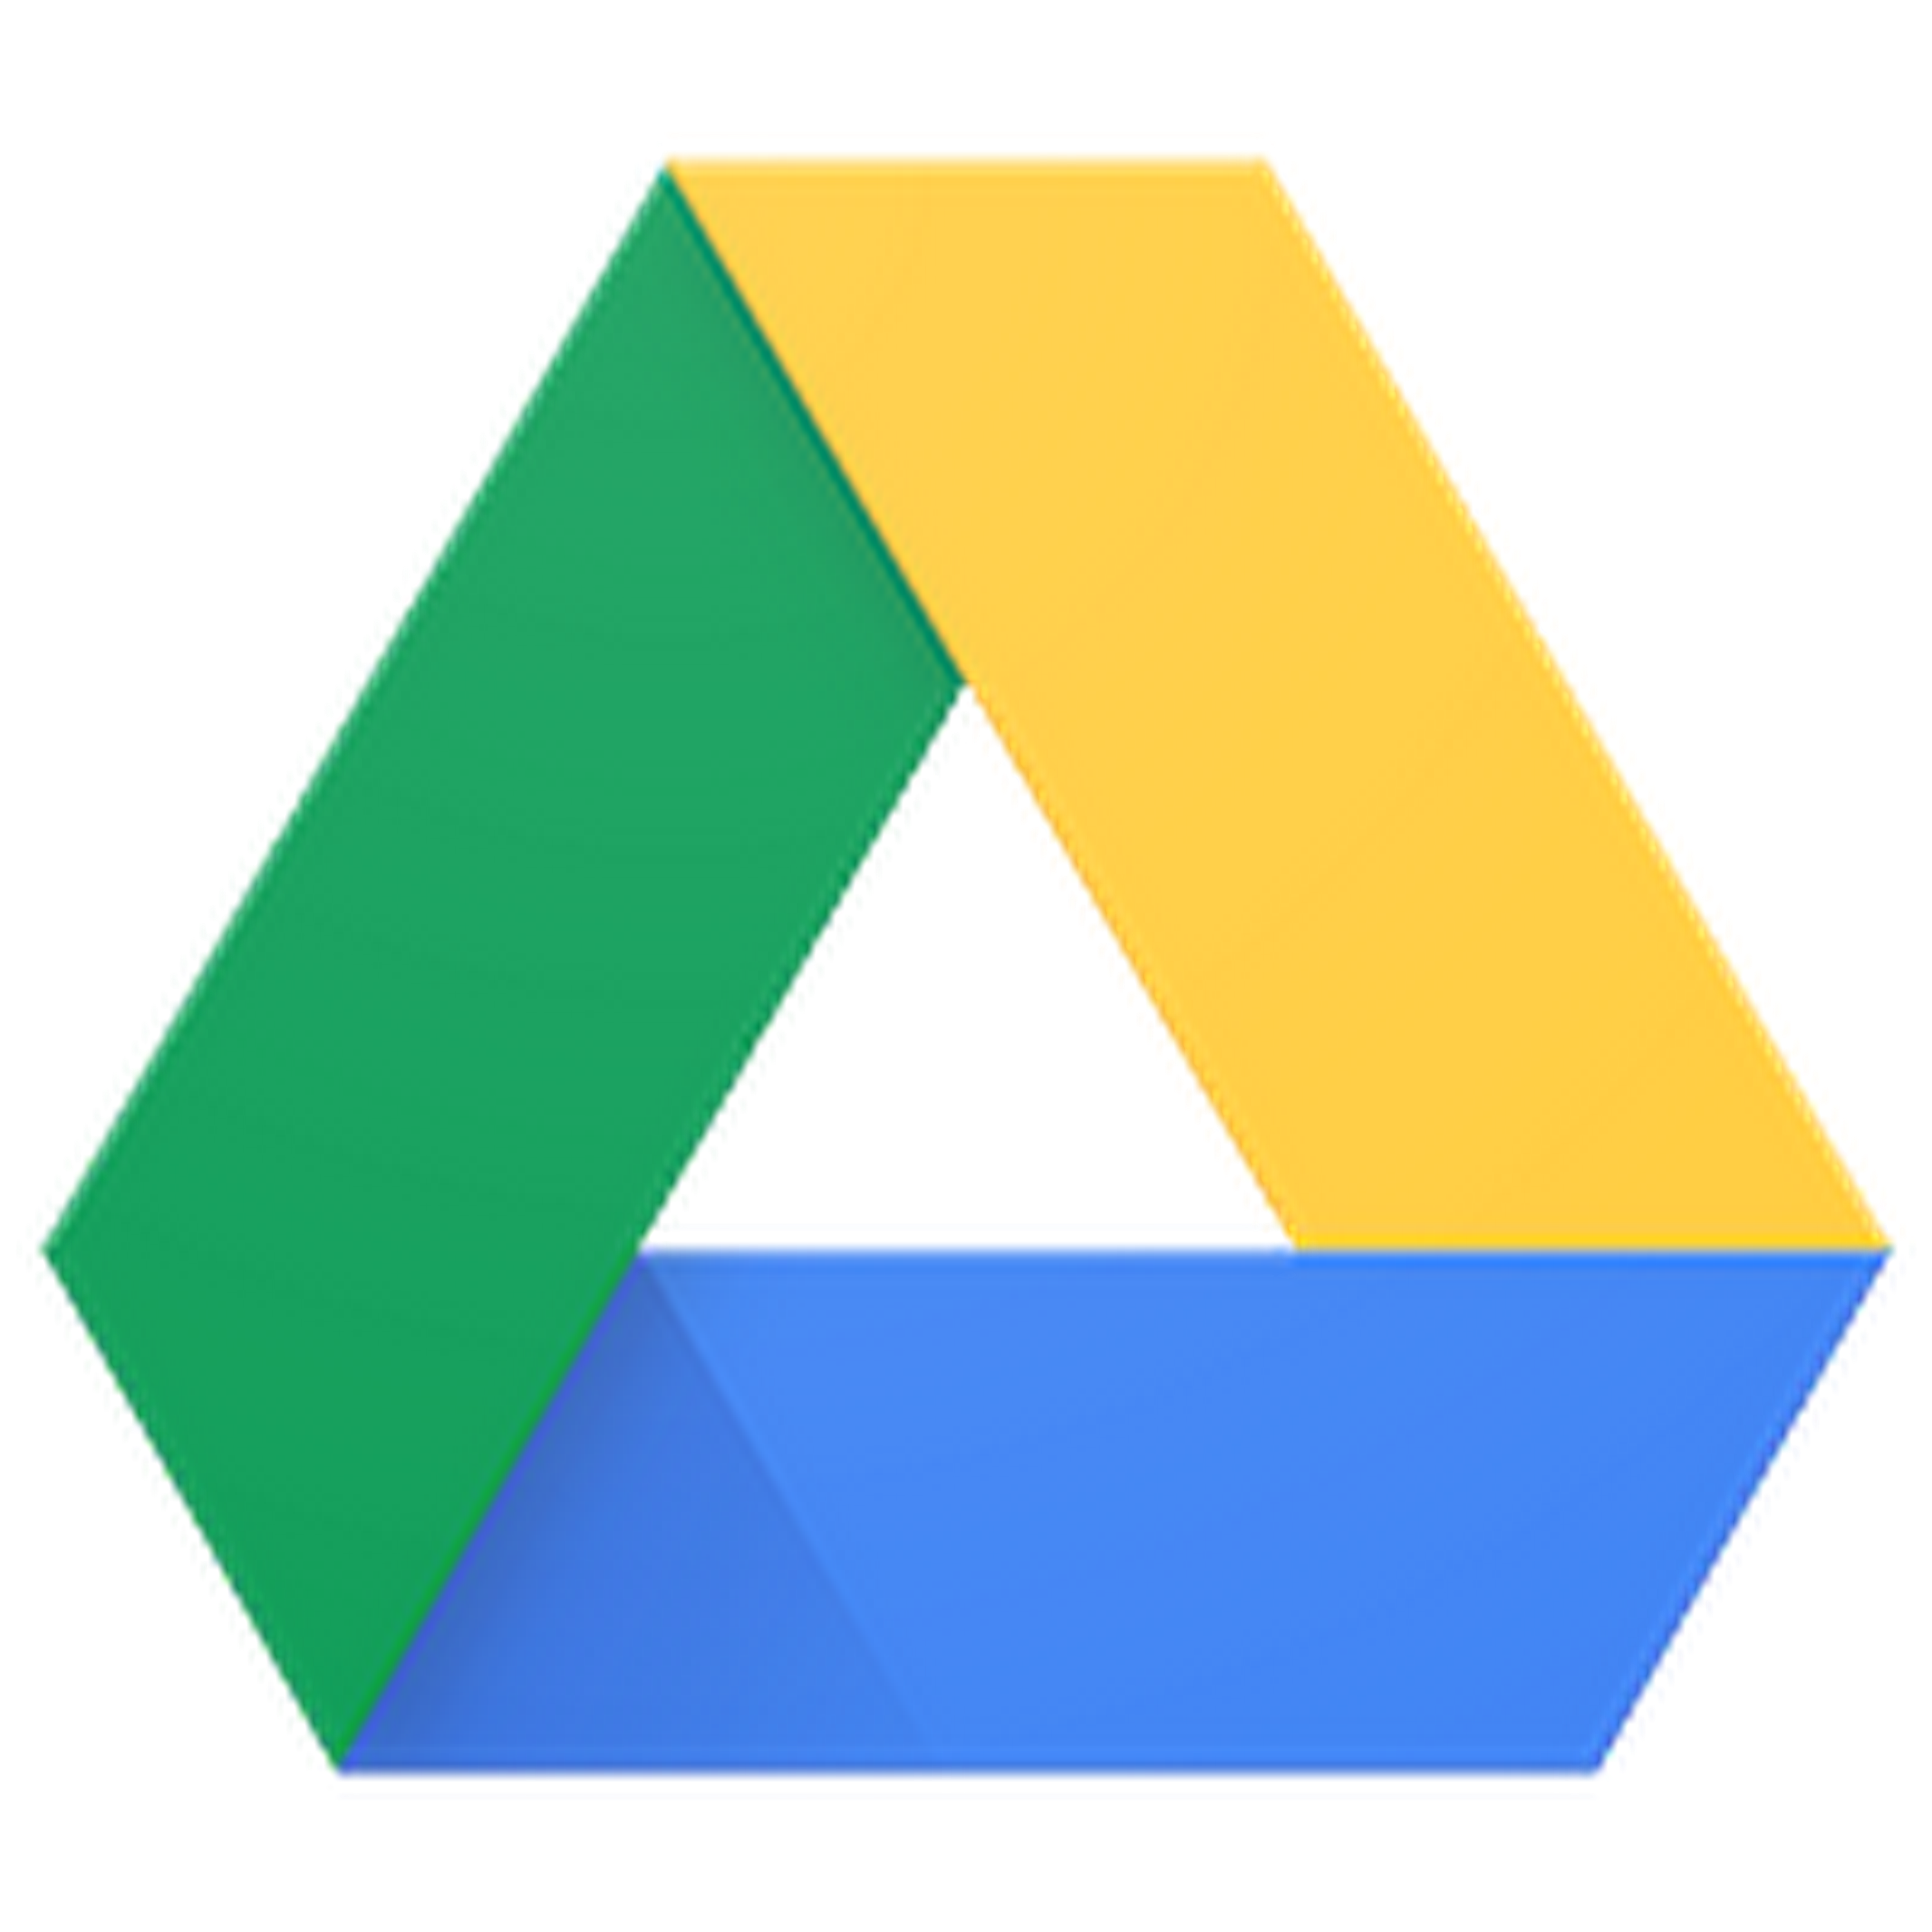
SERVICES ARE
PROVIDED BY
USES SAME INFRASTRUCTURE OF RELAIBLE INTERNAL SOFTWARES
SERVICES OFFERED INCLUDE
NETWORKING
STORAGE
MACHINE LEARNING TOOLS
CLOUD MANAGEMENT
COST EFFICIENT WITH COMMITMENT OF GOOGLE
DEVELOPERS TOOLS
SECURITY
BIG DATA
INTERNET OF THINGS
COMPUTE ENGINES

Slide 5
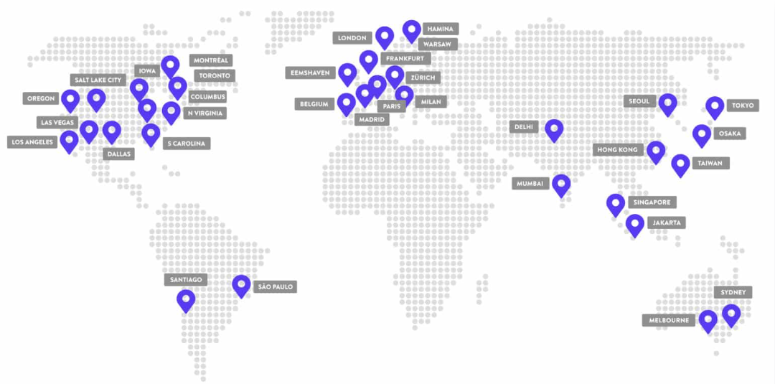
Google Data Centers
Google Cloud will continue expanding into the following regions:
Doha (Qatar)
Turin (Italy)
Berlin (Germany), Dammam (Kingdom of Saudi Arabia)
Tel Aviv (Israel).

Slide 6
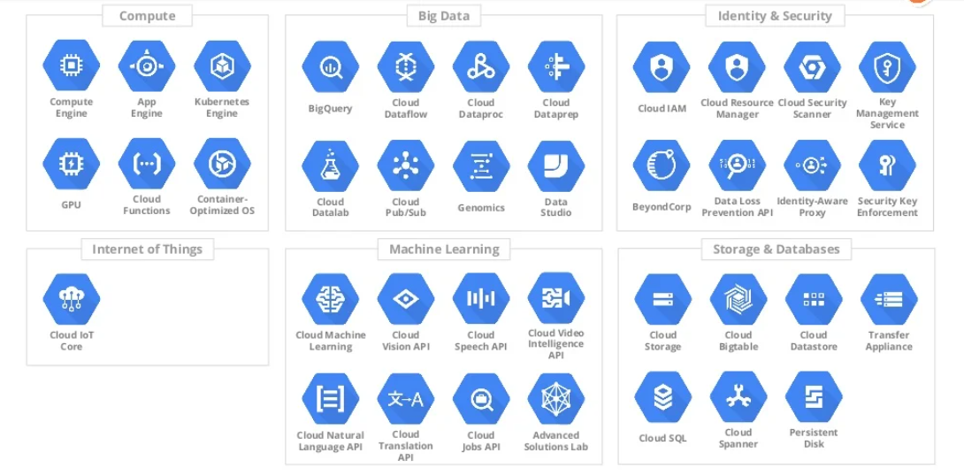
Services
More than 100+ services

Slide 7
Organization Structure

Slide 8
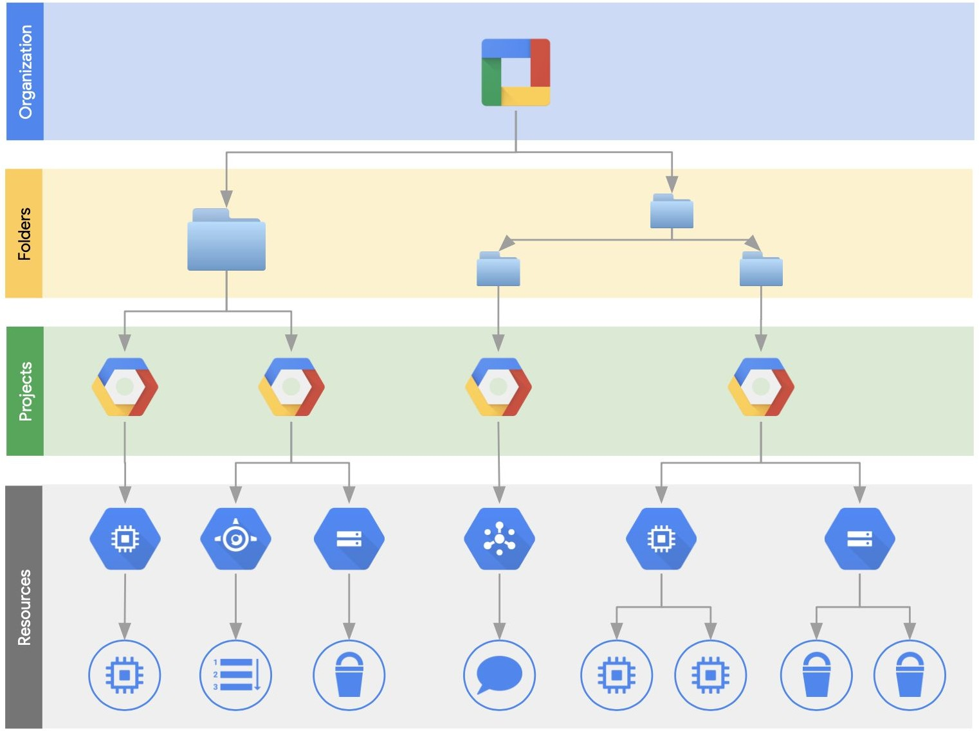
GCP Resource Management
Cloud Resource Manager provides project management & IAM functionality.
The top level component is the GCP organization.
An organization is tied to a GSuite OR a Cloud Identity account
Most of the available resources are deployed into a project.
A project is the main isolation “container” in GCP

Slide 9
CI/CD Using GCP

Slide 10
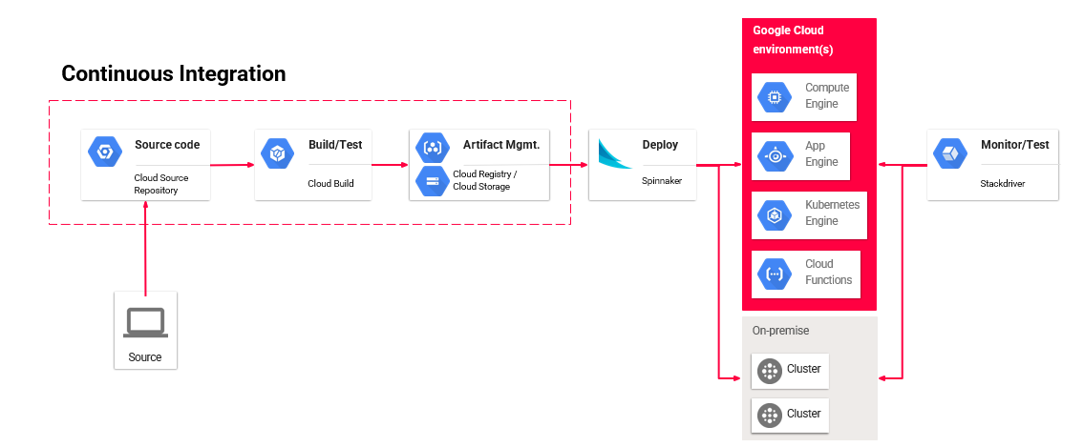
Continuous Integration and Delivery on GCP

Slide 11
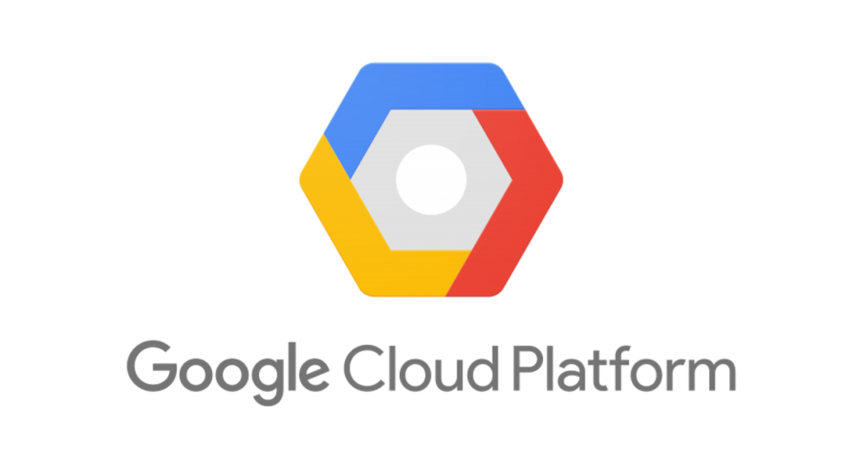
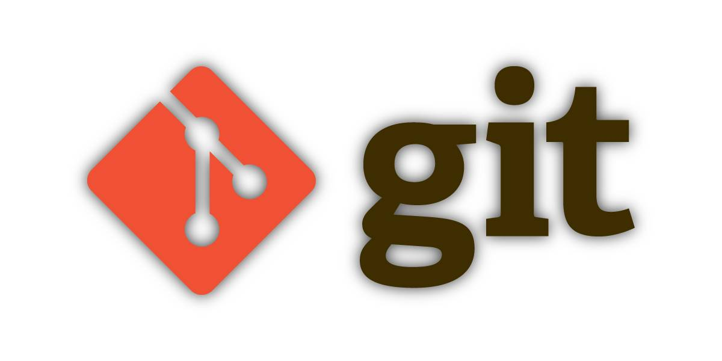
Cloud Source Repository
Google Cloud Source Repositories provides Git version control to support collaborative development of any application or service, including those that run on Google App Engine and Google Compute Engine
This Photo by Unknown Author is licensed under CC BY-SA

Slide 12
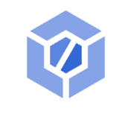
Cloud Build API
Cloud Build, Google Cloud’s continuous integration (CI) and continuous delivery (CD) platform, lets you build software quickly across all languages. Get complete control over defining custom workflows for building, testing, and deploying across multiple environments such as VMs, serverless, Kubernetes, or Firebase.

Slide 13
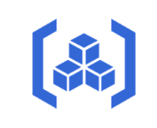
Artifact Registry
With Artifact Registry you can store and manage your build artifacts (e.g. Docker images, Maven packages, npm packages), in a scalable and integrated repository service built on Google infrastructure.

Slide 14
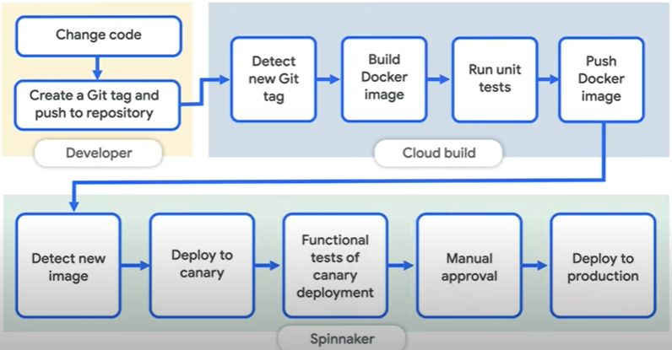
Spinnaker
Spinnaker is a free and open-source continuous delivery software platform originally developed by Netflix and extended by Google.

Slide 15
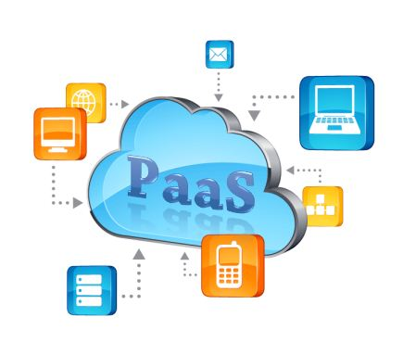

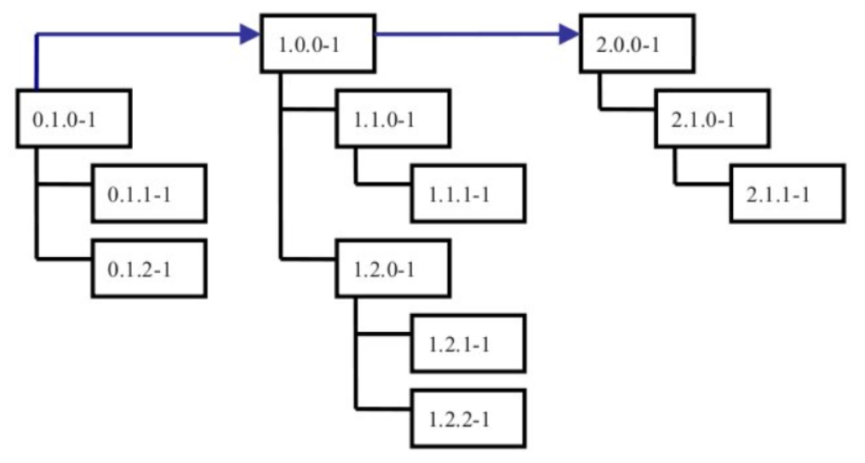
App Engine
Autoscaling
Versioning

Slide 16
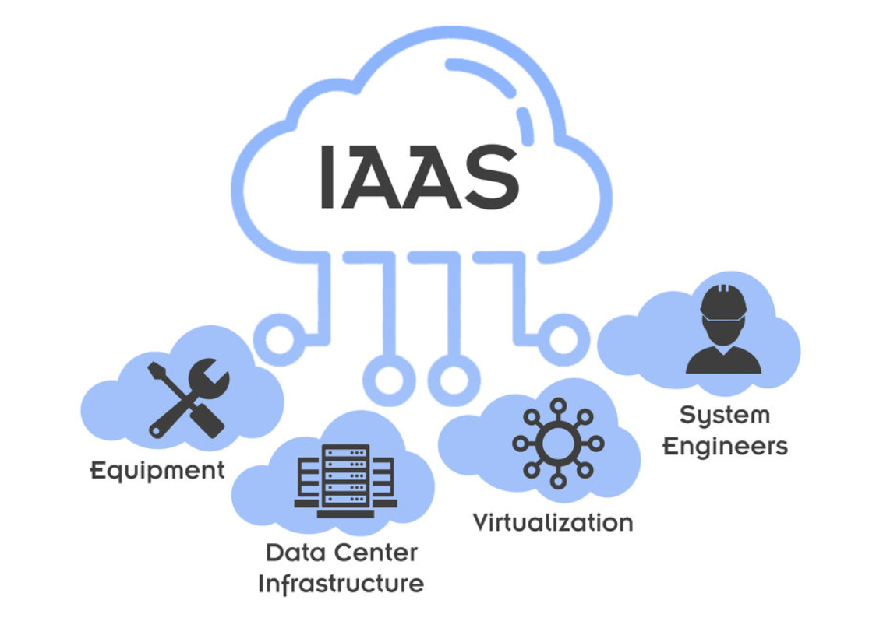
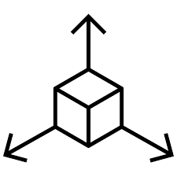
Compute Engine
IAAS
More Flexible
Chose OS and type of Hardware
Flexible

Slide 17
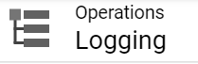
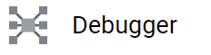
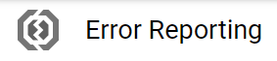
Monitoring

Slide 18
DEMO

Slide 19
“Hello World” Cloud run application
Enable the cloud run API
1
Write a simple JS application
2
Containerize the application
3
Save artifacts to artifact registry
4
Deploy on cloud Run
5
Clean up the resources
6

Slide 20
Questions ??

Slide 21
Thanks!!

